Slide 1
End-to-End Retail Performance and Behavioral Analytics
Presented by:
k.Pranith reddy

Slide 2
Abstract:
This project, titled ‘‘End-to-End Retail Performance and Behavioral Analytics,, This project analyzes the retail performance and customer behavior of Retail Nova Inc., a mid-sized retail and e-commerce company. The objective is to identify sales trends, customer insights, product performance, store profitability, and return patterns using data analytics.
The project includes data cleaning and exploratory analysis in Python, business metric calculations using SQL, and interactive dashboard creation in Power BI or Tableau. The findings support data-driven decision-making to improve profitability, optimize inventory, reduce returns, and enhance overall business performance.

Slide 3

Project Overview
• End-to-end retail analytics project
• Sales, Customers, Products, Stores, Returns
• Goal: Business insights using data
• Tools: SQL, Python, Power BI

Slide 4
INTRODUCTION
Retail organizations generate large volumes of transactional and customer data on a daily basis. However, without proper analytics, this data cannot be effectively utilized for decision making. Retail analytics enables businesses to identify sales trends, understand customer purchasing behavior, measure product performance, and optimize store operations.

Slide 5

Business Problem
• No clear visibility on sales and profit
• Hard to identify high-value customers
• Product returns impact revenue
• Store performance unclear

Slide 6

Project Objectives
• Analyze revenue and quantity
• Identify top products & customers
• Understand customer behavior
• Evaluate store performance
• Analyze returns

Slide 7
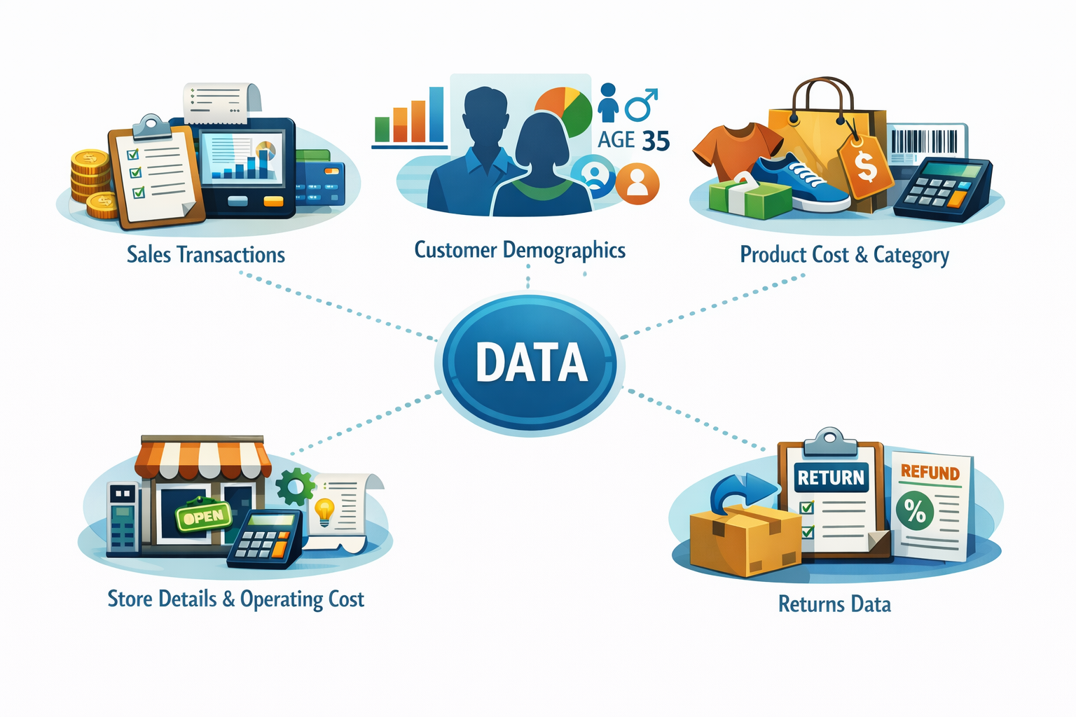
Methodology: Data collection and understanding
• Sales transactions
• Customer demographics
• Product cost and category
• Store details & operating cost
• Returns data

Slide 8
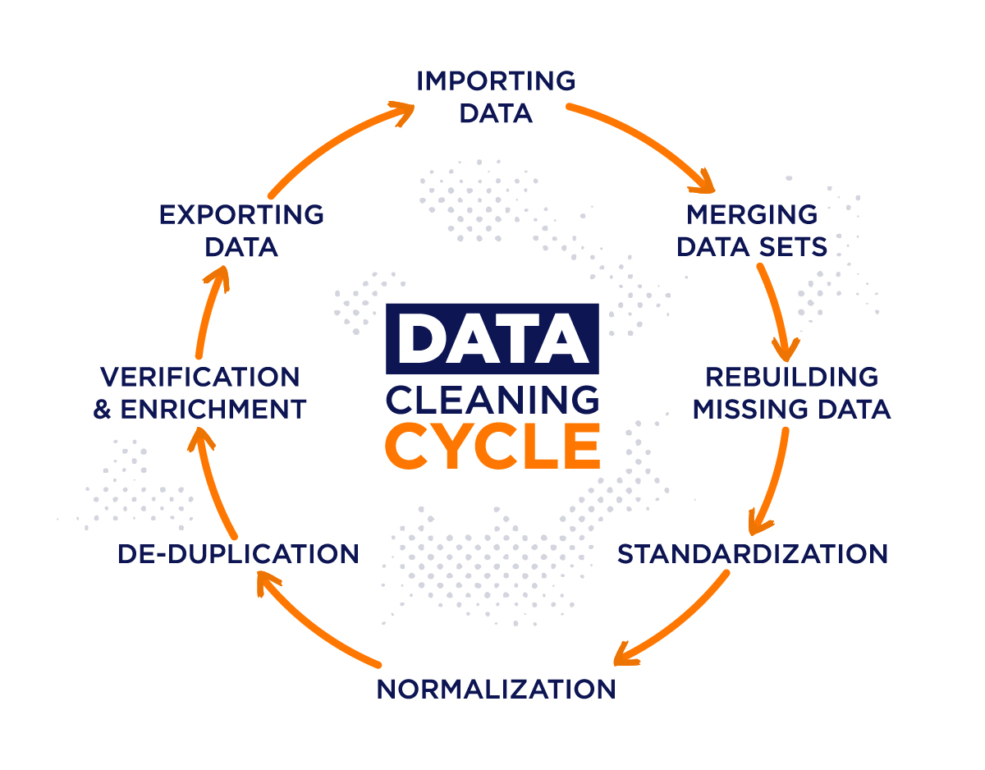
DATA CLEANING & PREPARATION
• Loaded datasets using pandas
• Validated data & null values
• Merged sales with product cost
• Calculated profit per transaction
Profit = Total Amount - (Cost Price × Quantity)

Slide 9
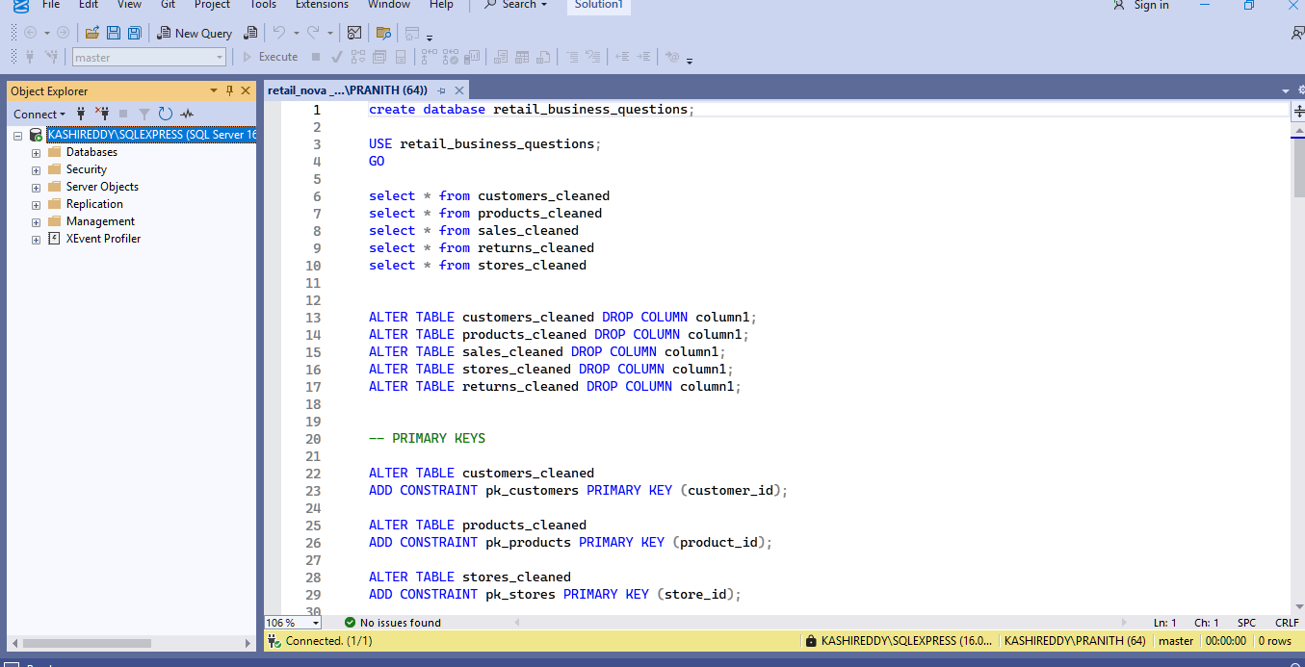
SQL-based analysis
• Cleaned tables
• Added keys & indexes
• Answered 10 business questions
• Revenue, profit, returns, store analysis

Slide 10
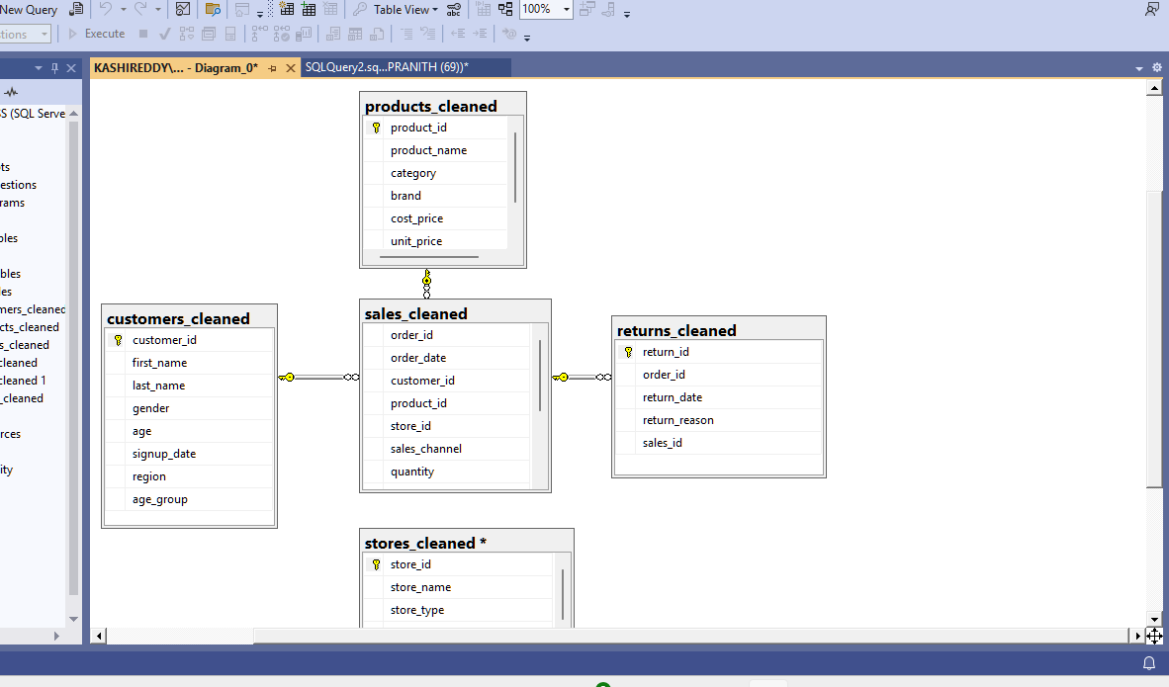
ER_DIAGRAM
A star-schema-based relational data model was created with the sales table acting as the central fact table. Dimension tables such as customers, products, stores, and returns are connected using primary and foreign key relationships.

Slide 11
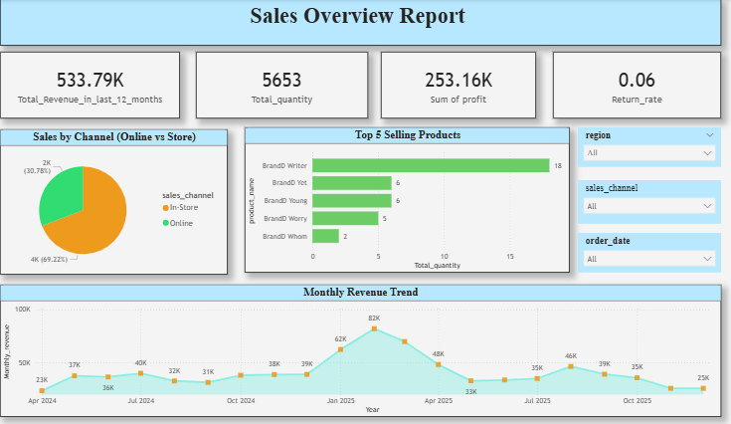
Power BI dashboard
SALES OVERVIEW DASHBOARD
Sales Performance Insights
Sales show clear seasonal trends with certain months performing significantly better.
A small set of products contributes a large share of total sales.
Online and in-store channels show different performance patterns.

Slide 12
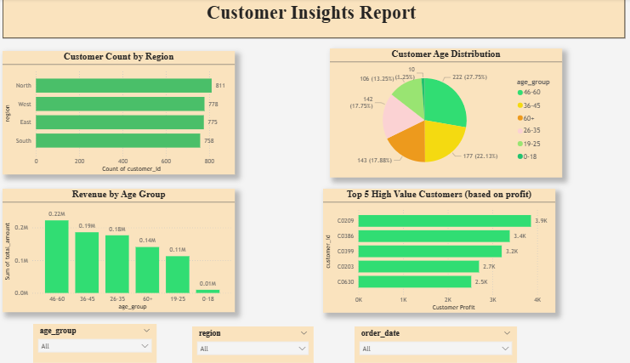
CUSTOMER INSIGHTS DASHBOARD
customer Insights
Customers from specific regions contribute more to revenue.
Certain age groups generate higher average revenue than others.
A small number of customers contribute disproportionately to total profit.

Slide 13
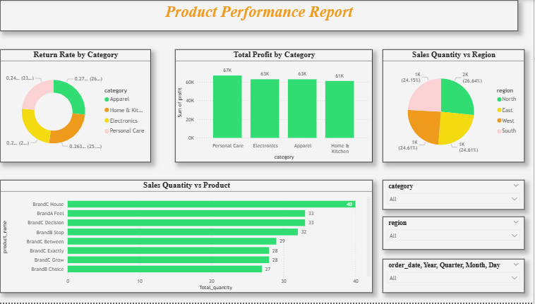
PRODUCT PERFORMANCE DASHBOARD
Product Performance Insights
Some product categories are consistently more profitable than others.
A few products have high sales volume but lower profitability due to returns or discounts.
Return rates are concentrated in specific product categories.

Slide 14
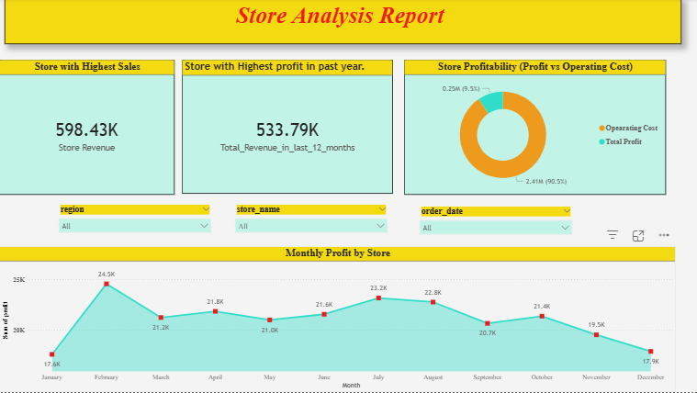
STORE ANALYSIS DASHBOARD
Store Performance Insights
Not all stores are equally profitable despite similar sales levels.
High operating costs reduce profitability for some stores.
Store performance varies significantly across regions.

Slide 15
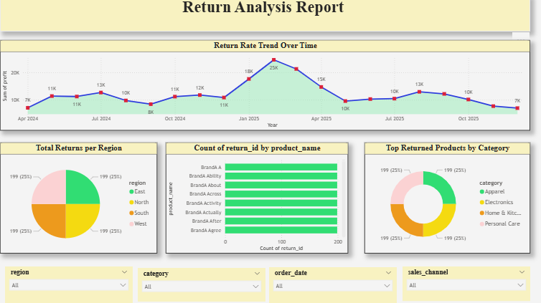
RETURN ANALYSIS DASHBOARD
Return Analysis Insights
Return rates have increased over time in specific categories.
Certain products and regions account for most returns.
High return rates negatively impact overall profitability

Slide 16
Key Business Insights • Few customers/products generate most profit • Operating cost impacts stores • Some categories have high returns
CONCLUSION
This Retail Sales Analytics project demonstrates a complete end-to-end analytics workflow using SQL, Python, and Power BI. By integrating data cleaning, analysis, and visualization, the project delivers actionable insights that support data-driven decision-making. The dashboards provide a clear, interactive, and professional view of retail performance, making this project suitable for real-world business applications.

Slide 17
THANK YOU!

